Slide 1
Improve Your ADF Fusion Application's Response Time by as Much as 70 Percent
Frank Houweling (AMIS, The Netherlands) ODTUG Kscope13

Slide 2
Customers do not accept slow applications anymore

Slide 3
Things are happening….
Too Slowly
Too Little
Too Often
Too Big
Too Soon

Slide 4
Things are happening….
Too Slowly

Slide 5
Slow database executions
Many bottlenecks are simply caused by slow ViewObject queries, PL-SQL calls or EntityObject DML operations
Often hard to track which queries are slow
Some queries are only slow for certain bind parameters
Some queries are not slow during in development environment but slow in production environment (that has much more data)
RDBMS
Notes:
For ADF tables, also a second query is executed to determine the number of result rows ( ‘select count * from’..). This query can be also a substantial problem if it is slow.

Slide 6
Measure execution time of ViewObject queries
Quick and simple way: Override executeQueryForCollection() method in project base ViewObject class to log executed database queries
start
stop
select *
from employees
order by name
Database

Slide 7
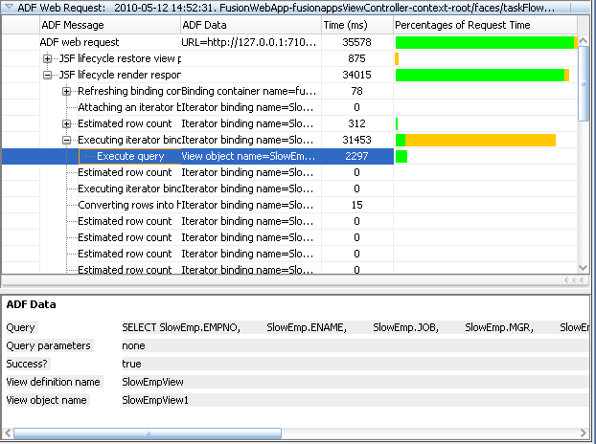
Other ways to detect slow database executions (1)
Oracle ADF Logger diagnostic tool in JDeveloper
Disadvantage: (too) much overhead for use in test- or production environment

Slide 8
Other ways to detect slow database executions (2)
Set up a database trace
-Queries from database perspective
-Disadvantage: database executions not from ADF application’s perspective, often not easy to relate database trace to ADF executions

Slide 9
Things are happening….
Too Often

Slide 10
Too many (mini) queries
Node 1
1 Query
Node 1.1
Another 2 queries
Node 1.1.1
Node 1.1.2
Node 1.2
Another 4 queries
Node 1.2.1
Node 1.2.2

Slide 11
Too often executed ViewObject mini-queries (1)
Applies to a lot of hierarchical structures
Master detail (.. Detail, …. Detail)
Default implementation of af:table, af:treeTable and af:tree with associations and viewlinks
ViewAccessor’s queries that are used for lookup items in af:table, af:treeTable and af:tree components
Custom ADFBC overrides and programmatically executed iterators
Nested <af:iterators> in a page

Slide 12
Solution
Page
Page(Def)
Managed bean
Page(Def)
ViewObject
ViewObject
Database
Database

Slide 13
Unintentionally left iterators in PageDefs
Page (UI)
PageDef (Bindings)

Slide 14
Too Many Database roundtrips (1)
Fetch size is set too low
ViewObject
Database tables

Slide 15
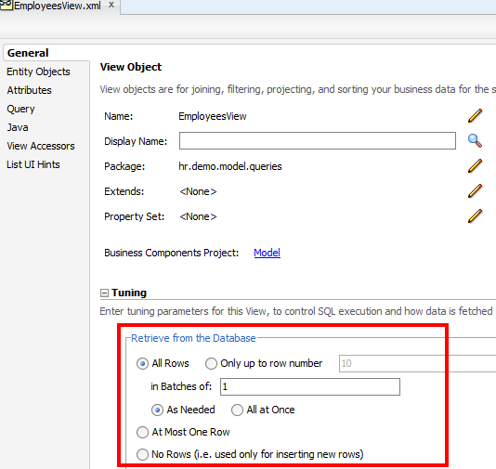
Too many database roundtrips (2)
The ViewObject fetch mode and fetch size properties (ViewObject General Tab - Tuning section) controls how many rows will be returned in each round-trip to and from the database

Slide 16
Too Many Database roundtrips (3)
Fetch size is set correctly
ViewObject
Database tables

Slide 17
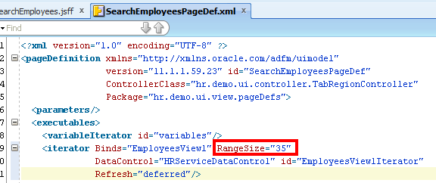
Too many HTTP Requests (1)
The iterator binding rangesize property represents the current set of objects to be displayed on the page
Rule of thumb: for af:tables, af:treetable and af:tree components set the rangesize to the max number of records that you can display in the browser, not more (usually not more than 50)
Notes:
For example, if a collection in the data control contains products and the iterator rangesize is 25, the first 25 products in the collection are displayed on the page

Slide 18
Too many HTTP Requests (2)
Make use of the powerful ADF AJAX capabilities
Set where possible on all af:command<xxx> components (buttons, links, menu-items, etc) partialSubmit="true“
HTTP Requests
Notes:
Partial Page Navigation is a feature of the ADF Faces framework that enables navigating from one ADF Faces page to another without a full page transition in the browser. The new page is sent to the client using Partial Page Rendering (PPR)/Ajax channel.
The main advantage of partial page navigation over traditional full page navigation is improved performance: the browser no longer re-interprets and re-executes JavaScript libraries, and does not spend time for cleanup/initialization of the full page. The performance benefit from this optimization is very big; it should be enabled whenever possible.

Slide 19
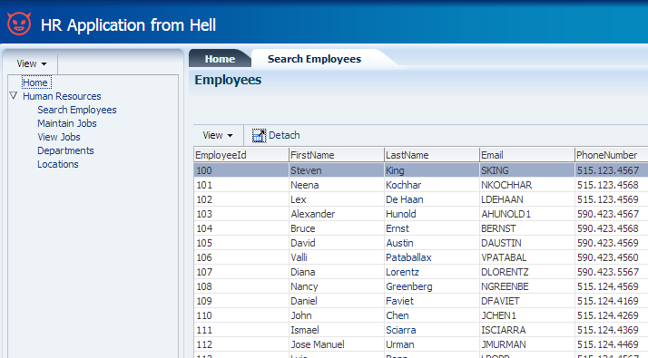
Demo
World’s most inefficient HR application !
Notes:
HR application with
-inefficient ViewObject fetchsize
-inefficient iterator rangesize
-Iterator refresh property=“IfNeeded”
-Old useless iterator that is still executing

Slide 20
Too much data in ADFBC memory (1)
Try to avoid loading more database rows than you need
Be careful if you really do need to load a proportional number of database rows

Slide 21
Too much data in ADFBC memory (2)
If you query a proportional number of database rows
many database rows memory consumption can be high
Use accessmode=Range Paging if you have to display +- more than 250 records in an af:table, af:treeTable or af:tree
Query resource intensive data only on demand (BLOBS, CLOBS, etc.)
Limit the ViewObject query result rows by bind parameters where possible
Use read-only ViewObjects where update is not needed (if EO based: deselect the updatable checkbox

Slide 22
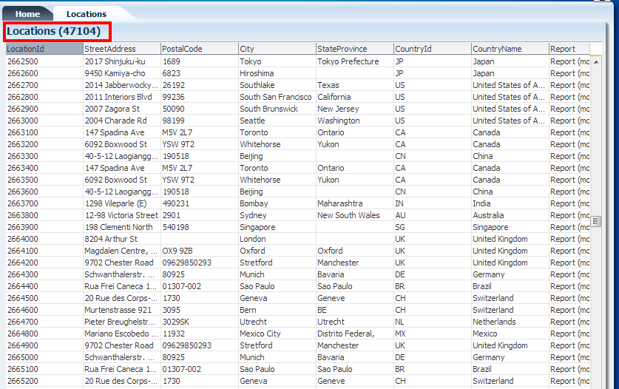
Demo ViewObject Range Paging

Slide 23
Too frequent ‘expensive’ ApplicationModule passivation & activation
Applicat
Application Module pool
AM 1
AM 2
AM 3
AM 4
AM 5
Database/File
Notes:
Application module (AM) pooling enables multiple users to share several application module instances. It may involve saving and retrieving session state data from the database. This mechanism is provided to make the application scalable and becomes very important under high load with many concurrent users

Slide 24
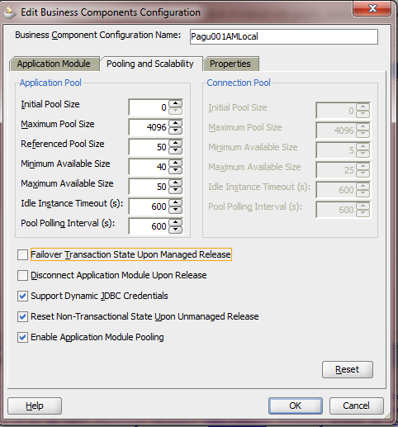
Too frequent ApplicationModule passivation & activation (2)
Often during development the AM pooling settings are not considered important and left at their default.
On a production environment, not setting these parameters correct (and leaving them at the default values) can be very inefficient and may cause many unneeded passivations and activations
Carefully read the documentation in the ADF Fusion developers Guide (Ch. 44 of the 11gR2 Fusion Developer Guide)

Slide 25
ApplicationModule pooling guidelines (1)
Recommended by Oracle Fusion Guide:
Oracle’s rule of thumb for setting the AM pool size is to set the maxavailablesize and the recyclethreshold parameters to the expected number of peak concurrent users that perform operations with short think times:
jbo.ampool.maxavailablesize = jbo.recyclethreshold
jbo.ampool.minavailablesize = 80 % of jbo.ampool.maxavailablesize
jbo.ampool.doampooling=true (default)
jbo.doconnectionpooling=false (default)
This avoids application module instantiation time when load increases - the hit is taken at server startup. This also avoids recycling (passivation cycle) of AM under normal load.
Notes:
Application Module Design Considerations
Designing an application's module granularity is an important consideration that can significantly impact performance and scalability. It is important to note that each root application module generally holds its own database connection. If a user session consumes multiple root application modules, then that user session can potentially hold multiple database connections simultaneously. This can occur even if the connections are not actively being used, due to the general affinity maintained between an application module and a user session. To reduce the possibility that a user can hold multiple connections at once, consider the following options:
Design larger application modules to encompass all of the functionality that a user needs.
Nest smaller application modules under a single root application module so that the same database connection can be shared among the nested application modules.
Use lazy loading for application modules. In the Application Module tuning section, customize runtime instantiation behavior to use lazy loading. Lazy loading can also be set JVM-wide by adding the following JVM argument:
-Djbo.load.components.lazily=true

Slide 26
ApplicationModule pooling guidelines (2)
Recommended by Duncan Mills:
Increase jbo.ampool.maxinactiveage
Set jbo.ampool.timetolive = -1
Results in more available AMs and avoid passivation/ activation costs
Recommended by Oracle Fusion Guide:
If your highest concern and priority is to limit the number of database connections, set jbo.doconnectionpooling=true (in combination with jbo.txn.disconnect_level=1), otherwise leave it at false (default)
Option for ADF applications with proportionally many root AMs, many users and many database connections for each user
Notes:
maxinactiveage
The number of milliseconds after which to
consider an inactive application module
instance in the pool as a candidate for removal
during the next resource cleanup.
The default is 600000 milliseconds of idle time
(which is 600 seconds, or ten minutes). A
lower value results in more application
module instances being marked as a candidate
for removal at the next resource cleanup. A
higher value results in fewer application
module instances being marked as a candidate
for removal at the next resource cleanup.
Timetolive
The number of milliseconds after which to
consider an connection instance in the pool as
a candidate for removal during the next
resource cleanup regardless of whether it
would bring the number of instances in the
pool below minavailablesize.
The default is 3600000 milliseconds of total
time to live (which is 3600 seconds, or one
hour). A lower value reduces the time an
application module instance can exist before it
must be removed at the next resource cleanup.
The default value is sufficient for most
applications. A higher value increases the time
an application module instance can exist
before it must be removed at the next cleanup.

Slide 27
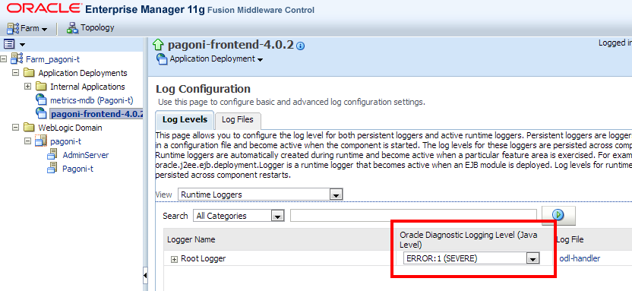
Too much logging on
Switch to SEVERE at the WLS / EM level

Slide 28
Things are happening….
Too Soon

Slide 29
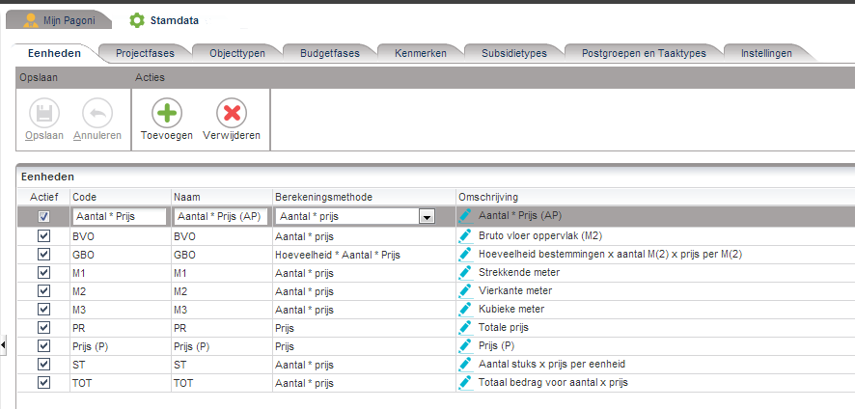
Executed too soon (1)
Example: af:panelTabbed component with in each af: showDetailItem an af:region that starts a taskflow execution

Slide 30
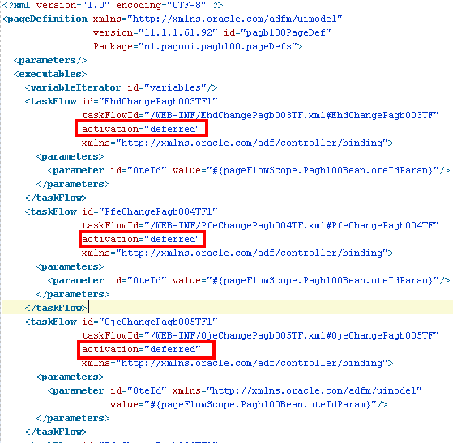
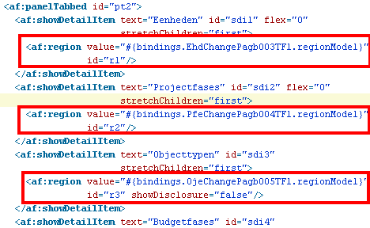
Executed too soon (2)
.jsff page:
PageDefinition:

Slide 31
Executed too soon (3)
Use childCreation="lazyUncached“ or childCreation="lazy“ to defer taskflow execution of all tabs until the tab is opened
For popups, use childCreation="deferred”
For tasklows in regions, use activation="conditional" and a RefreshCondition on the taskflow executable

Slide 32
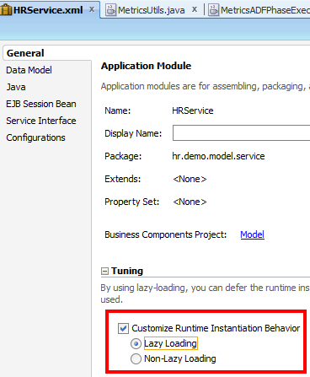
Instantiated too soon
Defer the runtime instantiation of ViewObject and nested ApplicationModule instances until the time they are used

Slide 33
Loaded too soon Immediate versus lazy
Important to consider for the following components:
af:table, af:treeTable, af:tree
af:popup
af:menu
dvt<xxx> (graphs)
Lazy delivery should be used for tables, or other stamped components, which are known to have a slow fetch time (when they show many records, or the query is slow)
Notes:
Lazy Delivery (default)Lazy delivery should be used for tables, or other stamped components, which are known to have slow fetch time. The examples are stamped components are the ones based on data controls using webservices calls or other data controls with slow data fetch. Lazy delivery can also be used on pages where content is not immediately visible unless the user scrolls down to it. In this case the time to deliver the visible context to the client will be shorter, and the user perceives better performance.Lazy delivery is implemented using data streaming technique. The advantage of this approach is that the server has the ability to execute data fetches in parallel and stream data back to the client as soon as the data is available. The technique performs very well for a page with two tables, one that returns data very quickly and one that returns data very slowly. Users see the data for the fast table as soon as the data is available.
Executing data fetches in parallel also speeds up the total time to fetch data. This gives an advantage to lazy loading in cases of multiple, and possibly slow, data fetches. While streaming is the default mechanisms to deliver data in lazy mode, parallel execution of data controls is not. In order to enable parallel execution, open the page definition and change RenderHint on the iterator to background.
In certain situations, the advantage of parallel execution is faster response time. Parallel execution could potentially use more resources due to multiple threads executing request in parallel and possibly more database connections will be opened.
Consider using parallel execution only when there are multiple slow components on the page and the stamped components belong to different data control frames (such as isolated taskflows). Since parallel execution synchronizes on the data control frame level, when there is a single data control frame parallel execution may not improve performance.
Immediate Delivery Immediate delivery (contentDelivery="immediate") should be used if table data control is fast, or if it returns a small set of data. In these cases the response time be faster than using lazy delivery. Another advantage of immediate delivery is less server resource usage, compared to lazy delivery. Immediate delivery sends only one request to the server, which results in lower CPU and memory usage on the server for the given user interaction.
-- popup --
The popup component is a container that contains a page fragment. The page fragment is hidden by default and requires a client action or event in order to be shown. The popup conditionally determines when markup is sent to the client by its contentDelivery property. The default content delivery is lazy. This means the content of the popup is not delivered to the client until shown the first time.
The options are:
lazy -- the default strategy described above. The content isn't loaded until you show the popup once, but then is cached.
immediate -- load the content onto the page immediately, so it displays as rapidly as possible. Use this for popups that are certain to be used by all users every time they use this page.
lazyUncached -- the content isn't loaded until you show the popup, and then is re-fetched every subsequent time you show the popup. Use this strategy if the popup shows data that can become stale.

Slide 34
Design your pages smart
Do not display too much data on a page, keep your page design simple if possible
Some organizations do still have old browsers (IE7) that can handle limited amounts of HTML and JavaScript
Do not unnecessarily query data that is not immediately needed (unopened tree nodes, inactive tabs, invisible popups, unopened dropdown lists, etc.)

Slide 35
Example bad practice ADF10g app
30%
15%
35%
?
5%
15%
Notes:
Example: Where does the application spend its time?
Check carefully whether the application does not do more than strictly is needed. In this example:
-hidden tabs are already queried
-an old iterator that is still in the pagedef (that was forgotten to be removed by a developer) executes still the VO query

Slide 36
Things are happening….
Too Little

Slide 37
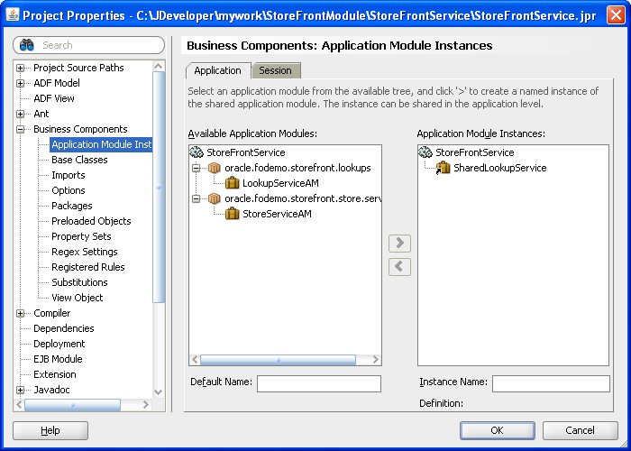
Too little Caching
Use a shared application module to group view instances when you want to reuse lists of static data across the application
Notes:
Web applications often utilize data that is required across sessions and does not change very frequently. An example of this type of static data might be displayed in the application user interface in a lookup list. Each time your application accesses the static data, you could incur an unnecessary overhead when the static data caches are repopulated from the database for each application session on every request. In order to optimize performance, a common practice when working with ADF Business Compone
Best Practice:
Use a shared application module to group view instances when you want to reuse lists of static data across the application. The shared application module can be configured to allow any user session to access the data or it can be configured to restrict access to just the UI components of a single user session. For example, you can use a shared application module to group view instances that access lookup data, such as a list of countries. The use of a shared application module allows all shared resources to be managed in a single place and does not require a scoped managed bean for this purpose.nts is to cache the shared static data for reuse across sessions and requests.

Slide 38
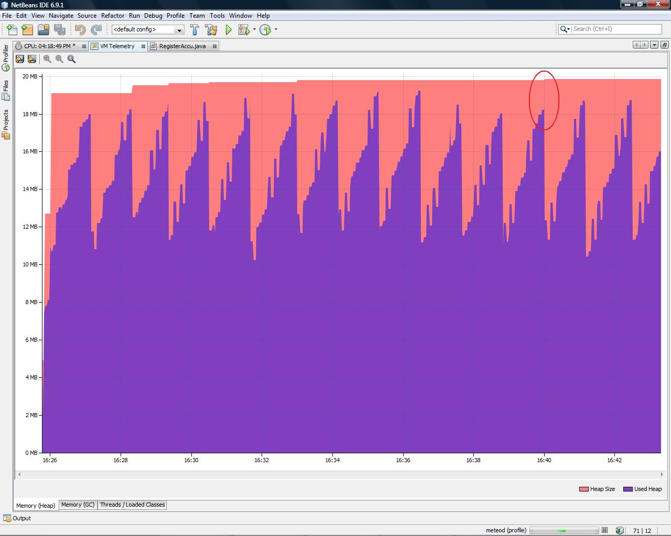
Too little JVM Heap size
Recommended by Duncan Mills:
Set (–Xms–Xmx) as large as possible within available physical memory
Generational parallel garbage collection strategy is recommended to maximize throughput: -Xgc:genpar (JRockit)

Slide 39
Things are happening….
Too Big

Slide 40
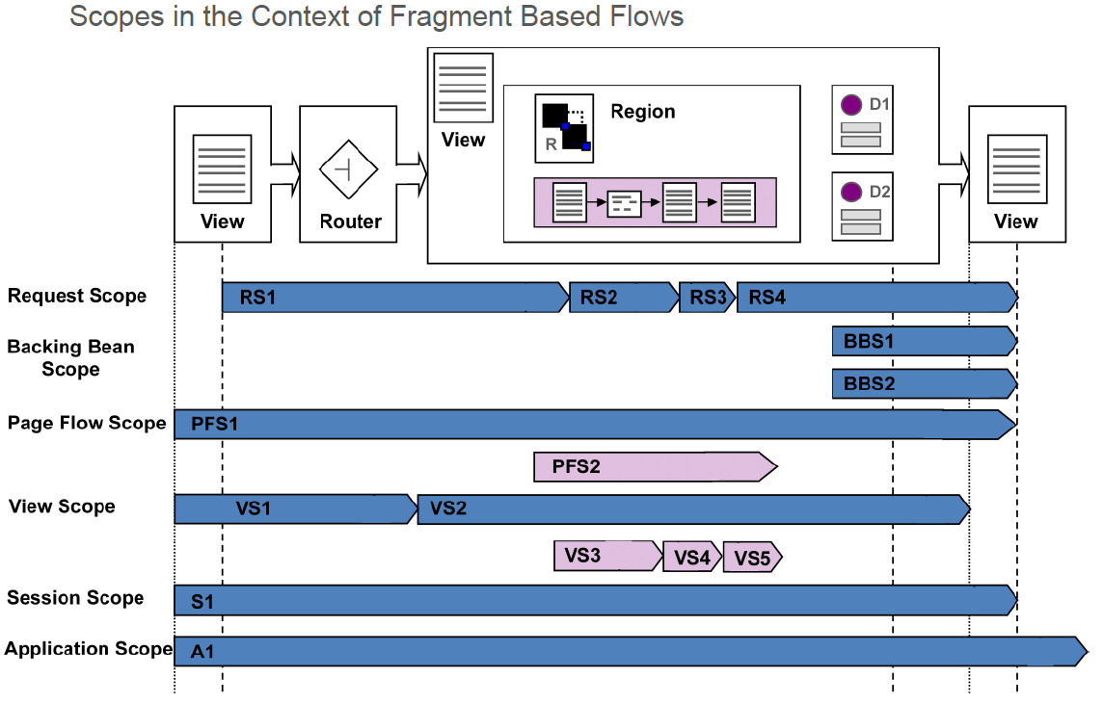
Too big scope for managed beans
Use as small memory scopes as possible
Notes:
Application scope: An application scope object is available for the duration of the application and is shared among users. This scope may be used to hold static objects that are the same for all users.
Session scope: The object is available for the duration of the session, which is user instance-specific. A use case for a session scope bean is a user info bean that stores information about a user, which is read from the database or an LDAP server, to avoid unnecessary queries.
Page flow scope: A pageFlow scope exists for each task flow instance and has a lifespan between request and session scope. The lifetime of the scope spans across all pages in a bounded task flow.
Request scope: The object is available from the time an HTTP request is made until a response is sent back to the client. From another perspective, a request scope starts with a request to be issued from one view to another for navigation cases that don't perform a redirect but a default server-side forward. The scope spans across all non-view activities that follow the view of interest to the next view activity.
Backing bean scope: The backing bean scope is comparable to the request scope, with the difference in that it exists for a specific client component. In general, all managed beans used in reusable components should be configured to backingBean scope. For example, bounded task flows that are designed to be regions on a page should use the backingBean scope if more than one instance of the task flow is expected to be on a single page.
View scope: The object is available until the view ID for the current view activity changes. This becomes handy when you use partial page rendering. If you have a dependent list box, you might send a server request to refresh the list box. When a response is returned, the request scope will be gone but the view scope will be still there. Therefore, view scope can be used to store data when partial rendering request comes back. The view scope exists not only for views that are rendered by JSPX pages, but also for views rendered by page fragments, as is the case in task flows that are built to execute in a region. The view scope of the parent page is not accessible from components added to a page fragement in a region, and the view scope of a view in a region is not accessible for the parent page.

Slide 41
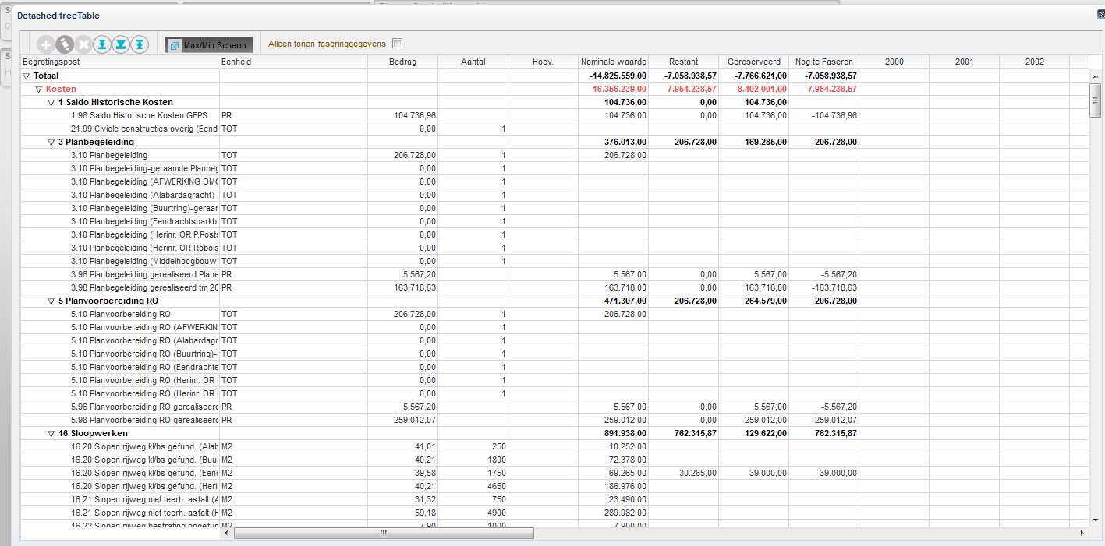
Too much HTML to the browser (1)
Make IDs of the following ADF faces container components as small as possible (max 2 characters):
af:pageTemplate
af:region
af:panelCollection
af:table
af:treetable
af:tree
af:iterator

Slide 42
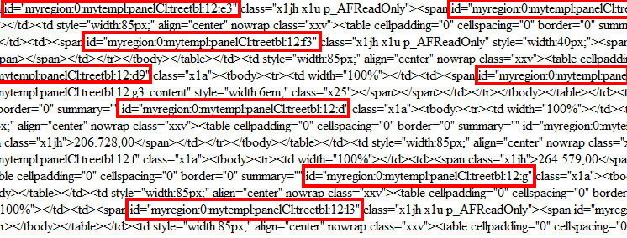
Too much HTML to the browser (2)
Monitor HTTP traffic in browser (for example firebug)
Look for big files
HTML

Slide 43
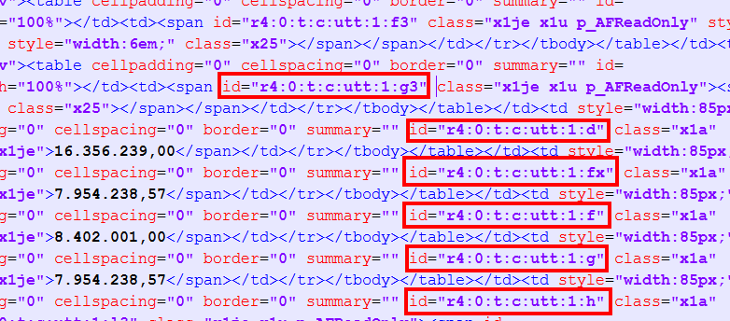
Too much HTML to the browser (3)
Make the container component IDs as small as possible, for example:
<af:pageTemplate id="t“ >
<af:panelCollection id="c“ >
<af:treeTable id=”utt” >
<af:region id="r4“ >
HTML

Slide 44
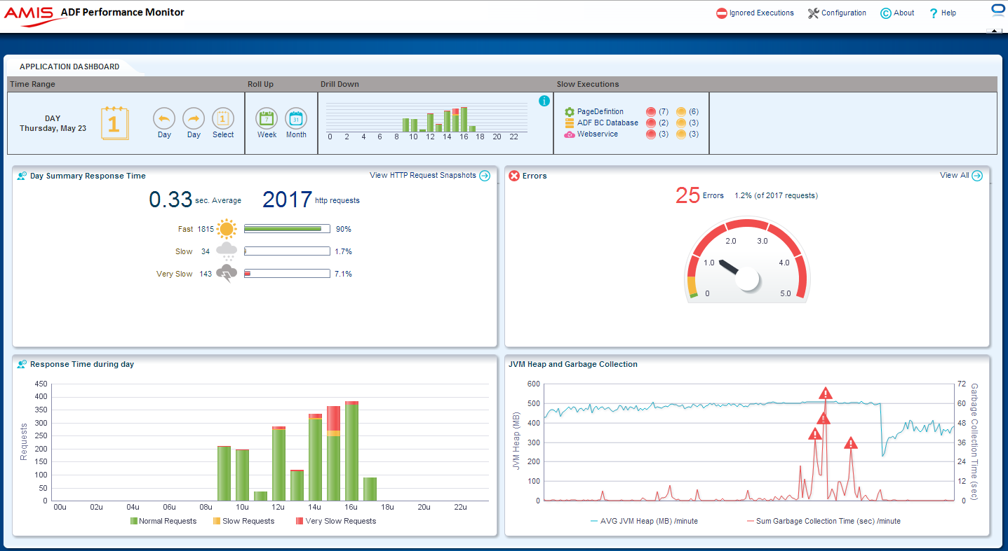
Demo ADF Performance Monitor

Slide 45
Summary ADF Performance Tips
Smart application design - do not unnecessarily query data that is not immediately needed (unopened tree nodes, inactive tabs, invisible popups, unopened dropdown lists, etc.)
Detect and avoid multiple unnecessary ViewObject query executions
Detect and tune ViewObject slow queries
Set efficient ViewObject fetchsizes
Set efficient PageDefinition Iterator rangesizes
Use partialSubmit=true where possible on: af:commandButton, af:commandImageLink, af:commandLink, af:commandMenuItem, af:commandNavigationItem, af:commandToolbarButton.
If you are working with more than 500 records in tables, set the ViewObject property accessmode to ‘Range paging’
Make IDs of ADF faces container components (af:pageTemplate, af:region, af:panelCollection, af:table, af:treetable, af:tree) as small as possible
Last but not least: Learn about (and try out) the most efficient Application Module pooling settings for your specific situation – it can save 30% of your performance

Slide 46
Resources
Fusion Middleware Performance and tuning guide
AMIS technology blog
Blogs by Duncan Mills
Blogs by Andrejus Baranovskis

